Slide 1

Unified Communications
AS a SERVICE (UCaaS)
Improve productivity and streamline communications for your team

Slide 2

Did you know?
The top-cited technologies seen as “very important” for getting work done efficiently
74%
73%
67%
communications
tools
remote
work
collaboration
tools
Source: Harvard Business Review, Making Technology an Integral Part of Your Employee Experience Strategy, 2020

Slide 3

Why UCaaS?
  Collaborate anywhere, anytime
  Reach your team in an instant
  Keep remote workers engaged
  Maintain productivity for road warriors
  Rely on flexible cloud communications
  Shift CapEx to OpEx
  Future-proof your communications
  Enable zero-touch, remote support

Slide 4

Delivering
Peace Of Mind
All the features you have today, plus advanced cloud-based calling features
Flexible, efficient, and future-friendly format
Service-level guarantees for all mission-critical functions
Lower operating costs and remote-work-ready
Disaster-proof and geographically redundant infrastructure

Slide 5

Key Features and Solution Suite OVERVIEW
Cloud/ hosted PBX
Business SMS
Virtual fax
E911
Web
conferencing &
collaboration
Mobility
And more…
SMS & voice broadcast
Appointment reminders
Enhanced applications
Call center
Microsoft Teams integration
Voicemail transcription
Voice API
Softphone
Desktop app
CRM integration
Outlook integration
Chrome extension

Slide 6

solution detail
Business SMS
Send and receive messages and images to and from extensions, 10-digit local, or long-distance numbers
Message colleagues, clients, and departments with a business identity—even from personal devices
Reply to an incoming message from a mobile app, desktop app, or by email
Text seamlessly across devices, including smartphones, tablets, and computers
Collaborate more effectively by communicating in a single text thread
Broadcast capability, appointment reminder platform, and drip campaign

Slide 7

solution detail
Web Conferencing
& Collaboration
Seamless user experience
Single sign-on
Webinars, conferences, and remote support sessions

Slide 8
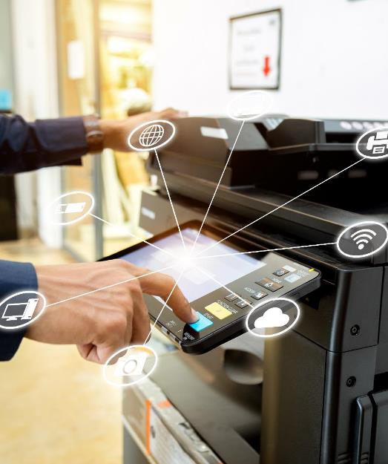
solution detail
Virtual Fax
Eliminate VoIP faxing issues with email- or cloud-based fax servers or store-and-forward
Support for faxing via analog, email, and web
Email notification of successful fax delivery

Slide 9

solution detail
Call Center
Carrier-class call center service
An all-in-one virtual call center suite that includes:
  ACD with call queuing
  Recording
  Administrative tools
  Queue analytics
  Extensive integration capabilities

Slide 10

solution detail
Enhanced Features
& Compliance
Phone numbers
  North American DID acquisition
  Partial number searches
  Purchase toll-free numbers
E911 (Kari’s Law and Ray Baum support)
Spam prevention and STIR/SHAKEN
Custom call routing
10DLC SMS
Rapid activation, provisioning and deployment

Slide 11

solution detail
Voice API
Innovative, integrated telephony, and UC services
Control call flow, media handling, and business logic
Integration with CRM and common billing systems
Easy-to-build applications

Slide 12
Questions?
<<Email>>
<<Phone>>
<<Website>>
<<Address>>

